Slide 1
Инновационные решения Fortinet
Родионов Михаил
Глава представительства Fortinet
19 Апреля 2018

Slide 2
















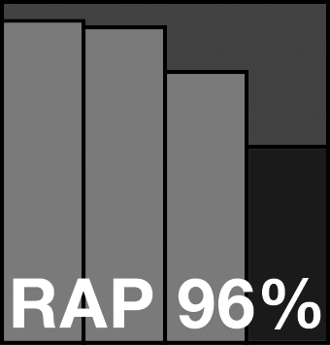

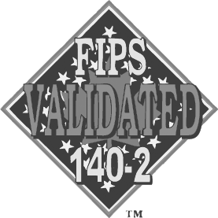


УВЕРЕННАЯ ПОЗИЦИЯ НА РЫНКЕ
3.4m
340K
Gartner
ENTERPRISE
FIREWALL
MAGIC QUADRANT
LEADER
НЕПРЕВЗОЙДЁННАЯ СЕРТИФИКАЦИЯ
НЕЗАВИСИМЫХ ЛАБОРАТОРИЙ
10
10
из
топ
УСТРОЙСТВ
БЕЗОПАСНОСТИ
ЗАКАЗЧИКОВ ИСПОЛЬЗУЮТ РЕШЕНИЯ FORTINET
Fortune ТЕЛЕКОММУНИКАЦИОННЫХ КОМПАНИЙ
30%
всех устройств мира
8
10
из
топ
9
10
из
топ
439
Fortune КОМПАНИЙ ЕВРОПЫ
Fortune КОММЕРЧЕСКИХ БАНКОВ И РИТЕЙЛ КОМПАНИЙ
9
10
из
топ
ПАТЕНТОВ
7
10
Fortune КОМПАНИЙ АЗИИ
из
топ
ПОЛУЧЕНО
291 В
ПРОЦЕССЕ
АВИА КОМПАНИЙ

Slide 3




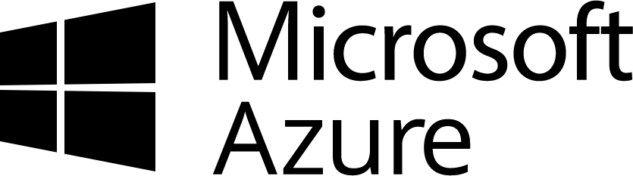














Fortinet фокусируется на 4 рынках безопасности
Инфраструктурная БЕЗОПАСНОСТЬ
ОБЛАЧНАЯ БЕЗОПАСНОСТЬ
Management
SIEM
Email
БЕЗОПАСНОСТЬ Iot & АСУТП
Sandboxing
Endpoint
WAF
network security
Switch
Wi-Fi
Notes:
Fortinet’s largest business is Network Security which includes many sub categories – Enterprise Firewall, UTM, VPN, IPS, SWG and more recently SD-WAN.
However, we provide solutions across 3 other large security markets. These are:
Infrastructure security (which includes endpoint, email and web application security, wired and wireless LAN, SIEM and more)
IOT/OT Security
Cloud Security, including Private and Public Cloud, as well as Cloud Security Access Broker (CASB)
As an FYI if you are interested the circles represents the relative projected size of these markets by 2020
Network Security - $25B
Infrastructure Security - $43B
IOT/OT Security - $9B
Cloud Security - $2.5B

Slide 4
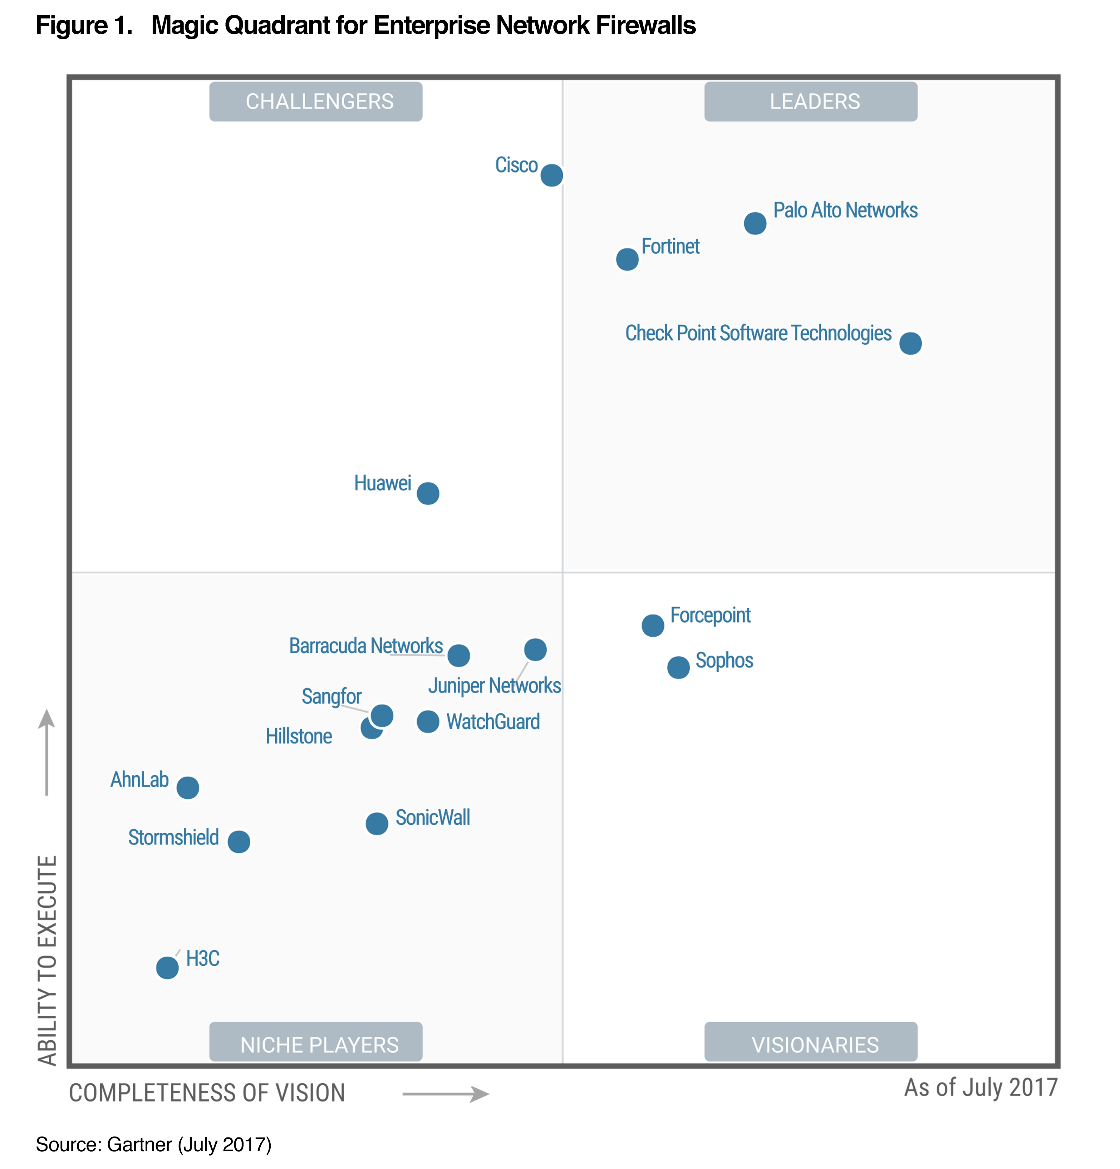
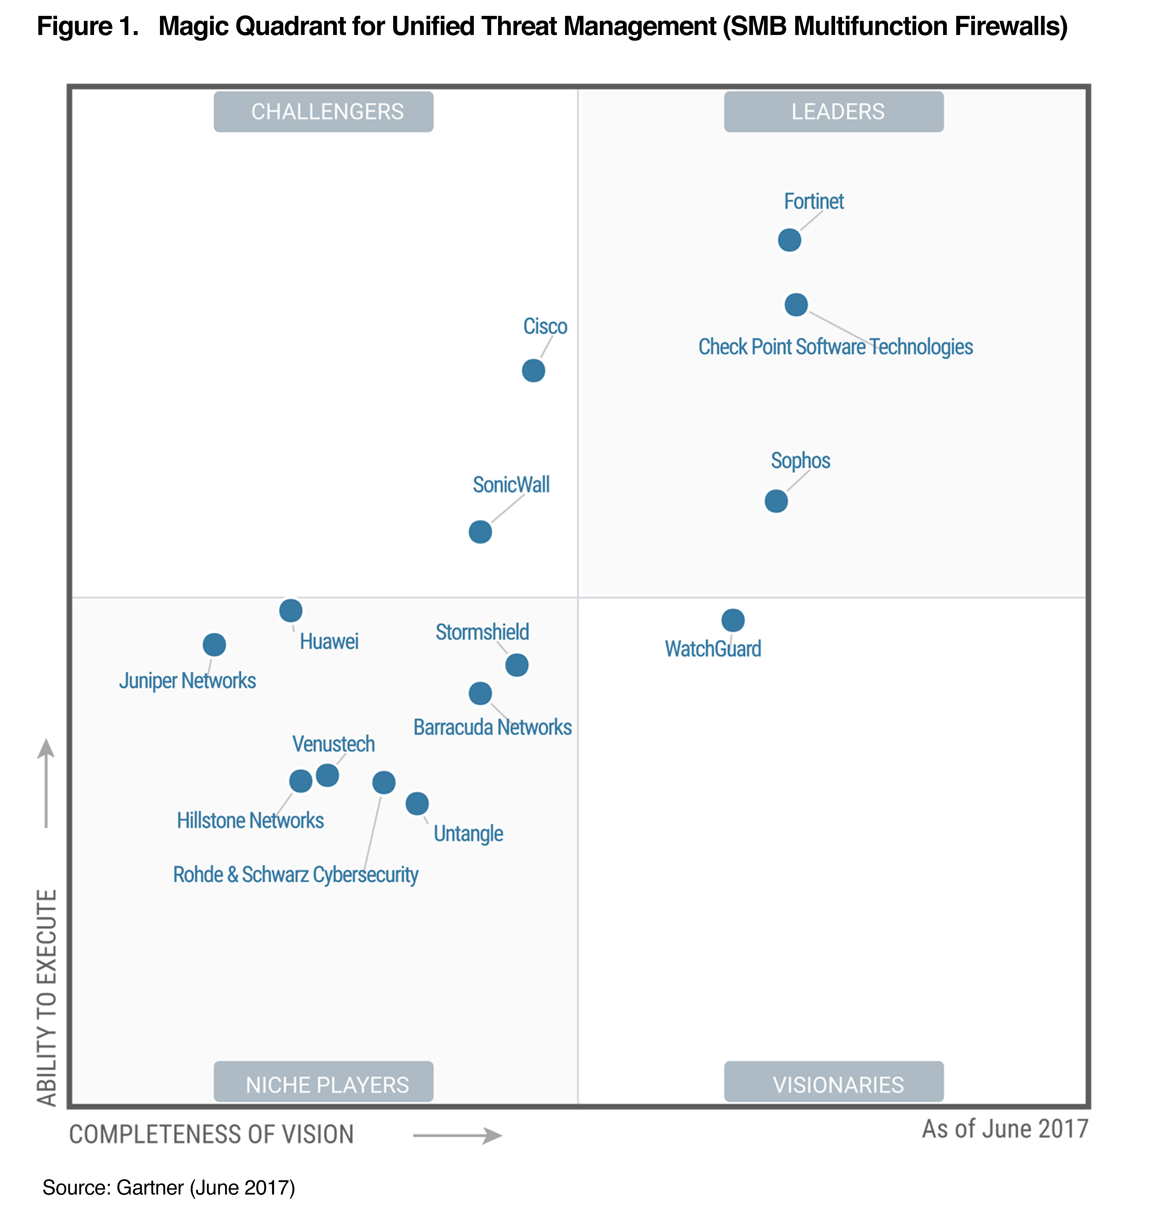
Лидер в области сетевой безопасности
Gartner Magic Quadrant for Enterprise Network Firewalls, Adam Hills, Jeremy D'Hoinne, Rajpreet Kaur, 10 July 2017
Disclaimer: This graphic was published by Gartner, Inc. as part of a larger research document and should be evaluated in the context of the entire document. The Gartner document is available upon request from Fortinet. Gartner does not endorse any vendor, product or service depicted in its research publications, and does not advise technology users to select only those vendors with the highest ratings or other designation. Gartner research publications consist of the opinions of Gartner's research organization and should not be construed as statements of fact. Gartner disclaims all warranties, expressed or implied, with respect to this research, including any warranties of merchantability or fitness for a particular purpose.
Gartner Magic Quadrant for Unified Threat Management (SMB Multifunction Firewalls), Jeremy D'Hoinne, Rajpreet Kaur, Adam Hils, June 2017
Disclaimer: This graphic was published by Gartner, Inc. as part of a larger research document and should be evaluated in the context of the entire document. The Gartner document is available upon request from Fortinet. Gartner does not endorse any vendor, product or service depicted in its research publications, and does not advise technology users to select only those vendors with the highest ratings or other designation. Gartner research publications consist of the opinions of Gartner's research organization and should not be construed as statements of fact. Gartner disclaims all warranties, expressed or implied, with respect to this research, including any warranties of merchantability or fitness for a particular purpose.
Notes:
Gartner provides analysis for many of these security markets. For more established markets they use the Magic Quadrant system to position each vendor.
Niche Players are for entrants or smaller players who serve a very specific market segment
Visionaries are players who show an interesting long term vision
Challengers have established a good customer base
Leaders have been executing will terms of both vision and customer base
Fortinet is recognized as meeting the enterprise requirements in more than 6 Gartner Magic Quadrants.
For Network Security the two main Magic Quadrants are Enterprise Firewalls (Includes NGFW) and Unified Threat Management (UTM- focused on SMB and Distributed Enterprise).
Fortinet is a LEADER in both these Magic Quadrants showing our vision and customer success for all use cases and segments.

Slide 5
Fortinet Patent Portfolio
Notes:
278 issued patents
236 pending applications
35 patent applications filed in Q4 2015
18 patents issued in Q4 2015

Slide 6
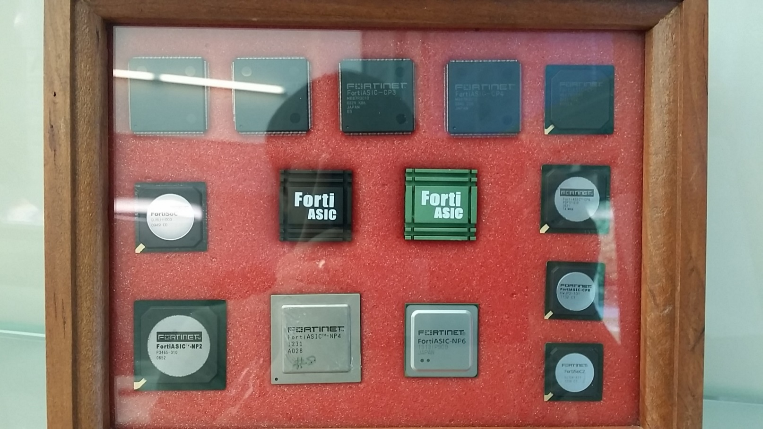
Модули обработки трафика FortiASIC

Slide 7






Преимущества использования SPU FortiASIC
CPU Only
«классический подход»
Архитектура Fortinet
Parallel Path Processing (PPP)
Больше производительность
Packet
Processing
Policy
Management
Content
Inspection
Optimized
Управление политиками
Обработка пакетов
CPU
SoC
Меньше задержка
Инспекция трафика
Меньше места в стойках
Большинство производителей оборудования
Решения Fortinet
Энергоэффективность

Slide 8
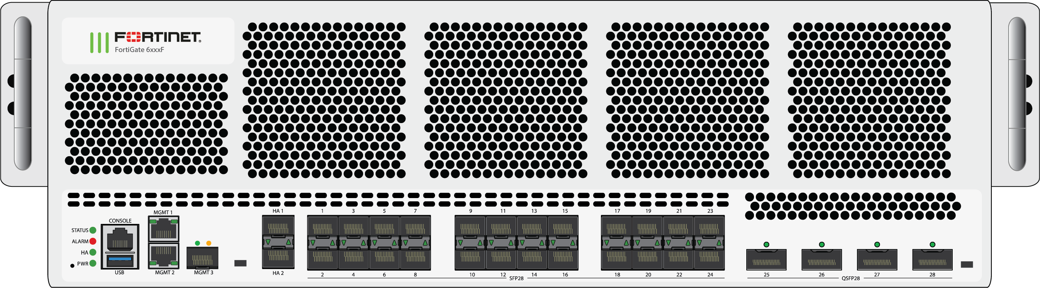
FortiGate Ultra High End – FG-6300F и FG-6500F
Новая линейка High End Next Generation Firewall
6000 серия
3 RU форм-фактор
Резервные блоки питания с «горячей заменой»
2TB SSD локальный диск
Ultra-high Performance Compact NGFW – до 100 Гбит/с производительности по показателю Threat Protection
Industry’s Highest SSL Inspection Performance – инспекция SSL-трафика на огромных скоростях
  Flexible Network Interfaces – широкий выбор сетевых интерфейсов 10G/25G/40G и 100G, поддержка современных архитектур, миграция с 10GE на 100GE
  Out of Band Logging – журналирование через выделенный интерфейс 10G SFP+ OOB

Slide 9

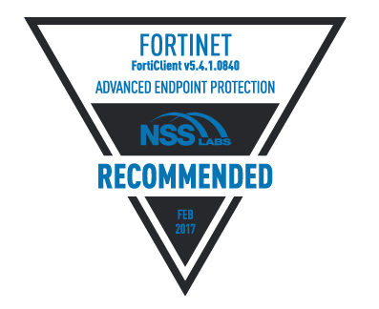
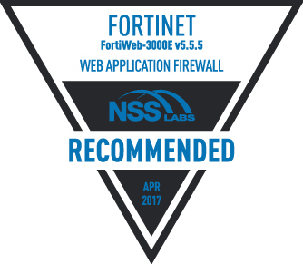
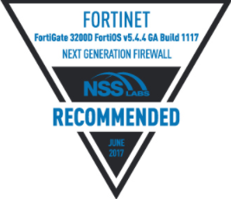
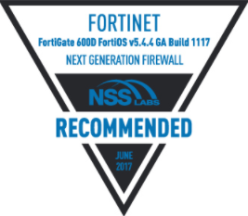
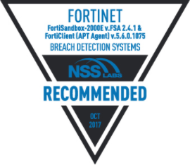
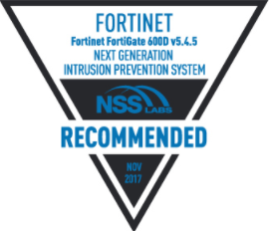
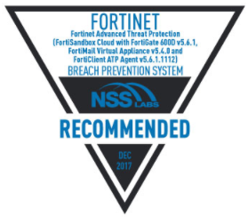
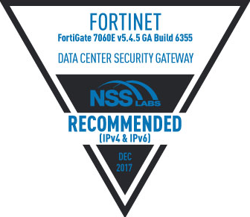
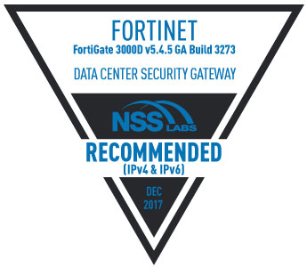
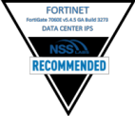
Непревзойдённая сертификация от независимых лабораторий
Результаты 2017 & 2018
#1
Сертифицированный производитель
Cisco
4
11
Check Point
4
Palo Alto Networks
2
AEP
WAF
NGFW
NGFW
BDS
NGIPS
BPS
DCSG
DCSG
DCIPS
DCIPS
Notes:
At the same time, we have earned more independent certifications in 2017 than any competitor. Rigorous testing, either yourself and/or by a credible and experienced test lab is essential before making a major Network Security decision. Although vendors try to make data sheets accurate every customer has there own environment and it’s critical to ensure the solution you select will meet your specific requirements in production.
As an example, NSS Labs provides free (Not pay to play) testing of many Security Use cases. Including
Firewall
NGFW
Data Center FW
Next Generation IPS
Data Center IPS
Breach Detection System
Breach Prevention System
Advanced Endpoint Protection
Web Application Firewall
To receive a recommendation not only do you need to be best in class price/performance but also best in class security effectiveness. This very hard to achieve over so many use cases.
But in 2017 Fortinet have received 11 recommendations for his products. Our major competitors have 4 at the most and some none at all.
Fortinet’s commitment to 3rd party testing shows our confidence in our technology to protect your network and data. It also provides extra sets of eyes to ensure the quality of our products.

Slide 10
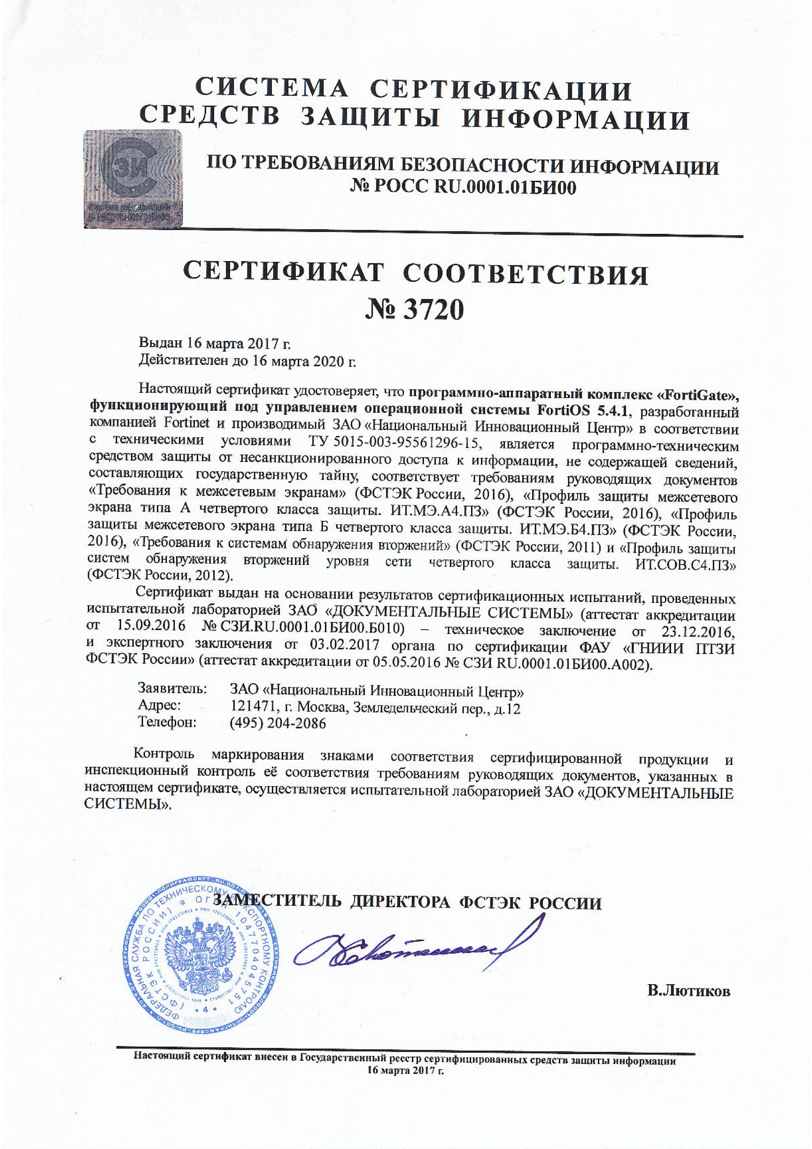
Сертификация в России: ФСТЭК
Сертификат от 16-го марта 2017 и единственный по новым требованиям среди иностранных производителей, лидеров сегмента Enterprise Firewall по версии Gartner
Требования к межсетевым экранам ” ФСТЭК России 2016”
Профиль защиты межсетевых экранов типа А четвёртого класса защиты (ФСТЭК России 2016)
Профиль защиты межсетевых экранов типа Б четвёртого класса защиты (ФСТЭК России 2016)
Профиль защиты систем систем обнаружения вторжений уровня сети четвертого класса защиты (ФСТЭК России 2012)
Требования к системам обнаружения вторжений (ФСТЭК России 2011)
Классификация по уровню контроля отсутствия недекларированных возможностей – по 4 уровню контроля (Гостехкомиссия России)

Slide 11


DX
[Digital Transformation]
Интеграция информационных технологий во все аспекты бизнеса, фундаментально меняющие функционирование бизнеса и добавляющие ценность для заказчиков
Notes:
Digital transformation
Digital transformation is the profound transformation of organizations to fully leverage the opportunities brought by digital technologies.
Today organizations see security as one of the biggest obstacles of their digital transformation.

Slide 12

SX
[Security Transformation]
Интеграция безопасности во все области информационных технологий, фундаментально меняющая архитектуру безопасность, её применение и эксплуатацию
Notes:
The cyber security brought by digital transformation drive for a transformative approach to security.
At Fortinet we call it Security Transformation
Security must be transformed to be found at every point of interaction of the data.
It must be found in all areas of digital technologies.
You can not continue the old way of addition new device/point product to resolve new pb.
You must have full control and visibility and automation across the entire network

Slide 13
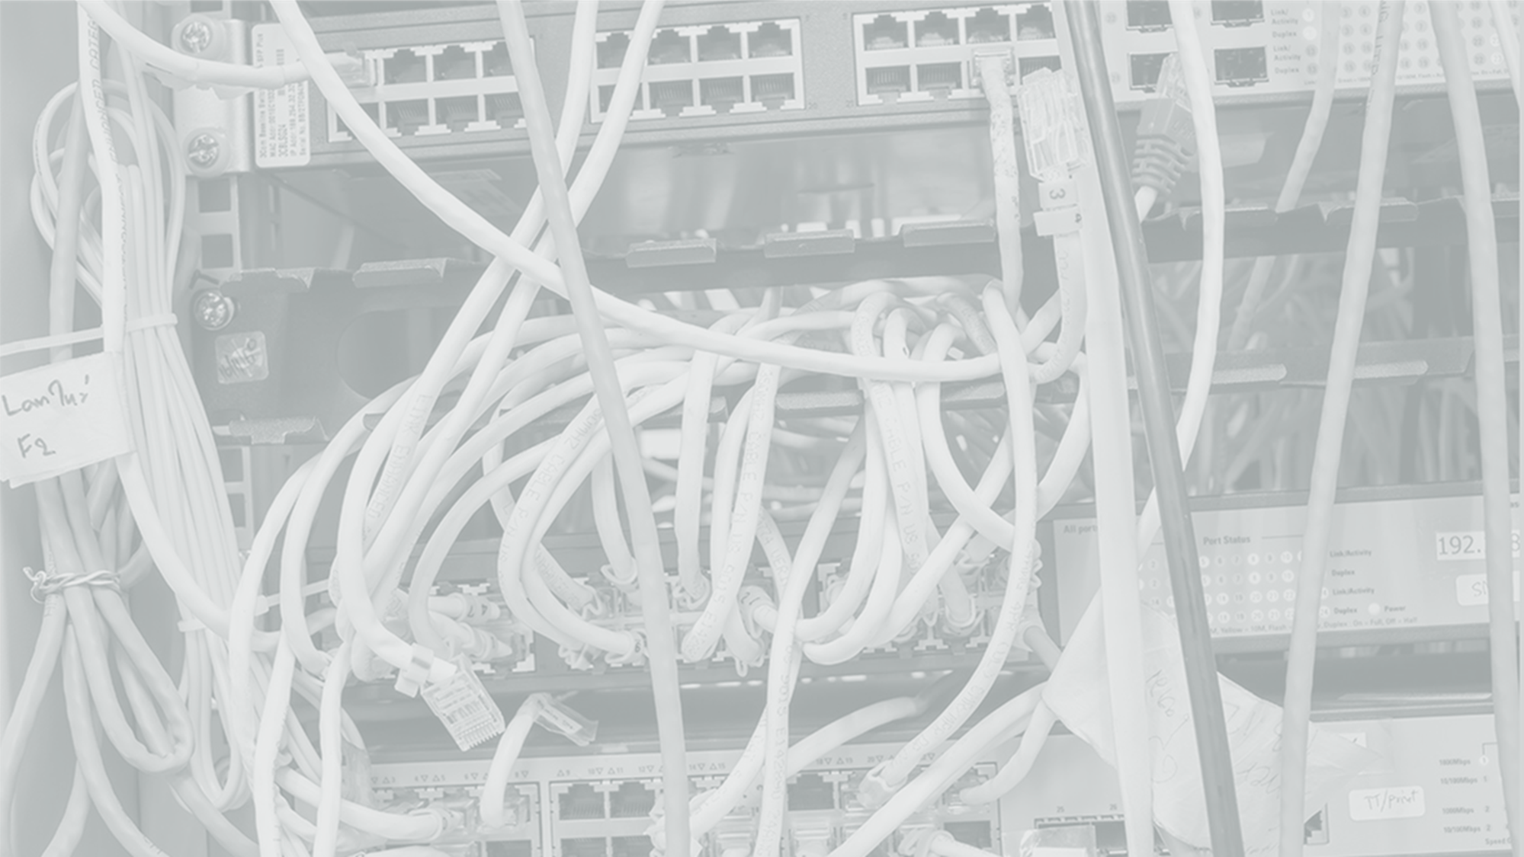
Безопасность требует нового подхода
Сетевая безопасность первого поколения
1995-2005 Connection
SOFTWARE
Stateful Firewall
Notes:
The first generation of network security started about 25 years ago; it’s all about securing the connection.
Such as my previous company NetScreen, use Firewall to control who can connect together and VPN to encrypt the connection.
It worked well when the data content is not active and rich.

Slide 14



Безопасность требует нового подхода
Сетевая безопасность второго поколения
2005-2015 Content
SOFTWARE
NGFW/UTM
SECURITY PROCESSORS
Notes:
The second generation of network security started 17 years ago when Fortinet was founded.
It’s about how to secure inside the connection, secure the application and content from firewall policy permitted connection, and remove the malware inside permitted connection.
Fortinet pioneered and leads the second generation network security.

Slide 15




Безопасность требует нового подхода
Сетевая безопасность третьего поколения
2015+ Borderless
SOFTWARE
Fabric
Infrastructure
Cloud Security
Application Security
SECURITY PROCESSORS
Network Security
Access Security
FABRIC INFRASTRUCTURE
Client/IoT Security
Notes:
Today compare with 17 years ago when Fortinet was founded, what changed? Mobile, Cloud, IoT.
Majority of the data no long stay inside company network and servers protected by firewall.
Only secure a few points and connections by system/platform on the network no longer enough

Slide 16

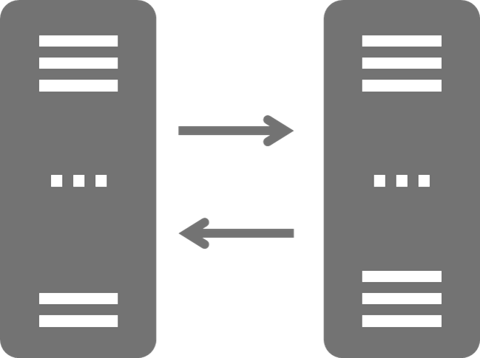

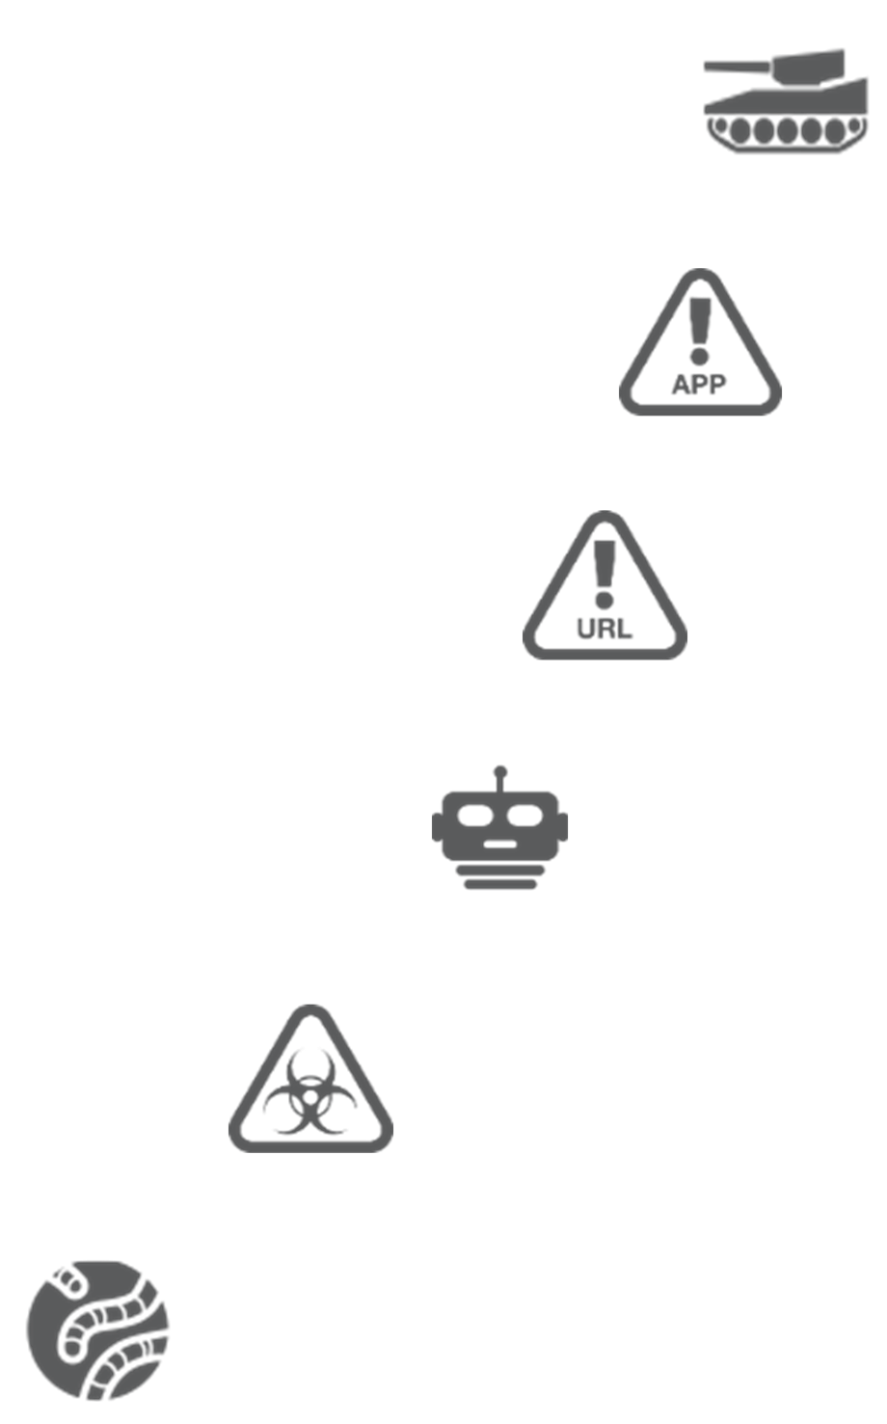
Угрозы стали более интеллектуальными
Machine to Machine Attacks
Fabric
Generation 3
INFRASTRUCTURE
Advanced
Targeted Attacks
Advanced Threat Protection
Malicious
Apps
Application Control
Malicious
Sites
Web Filter
Performance Degradation
Spam
Botnets
Generation 2
CONTENT
Anti-spam
Viruses
& Spyware
Antivirus
Intrusion
& Worms
Layer 5-7:
Content & Application
IPS
Layer 3-4:
Connection
Firewall/VPN
Layer 1-2:
Physical
Lock & Key
Generation 1
CONNECTION
Hardware Theft
1980s
Today
Notes:
2 years ago my presentation here at GPC is about Internal Segmentation
Last year, we talked about 3 big issues related network security: Borderless, performance & complexity.
All these lead to today’s third generation of network security: Secure the Infrastructure---Fortinet Security Fabric.

Slide 17








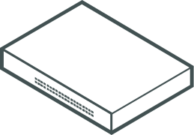
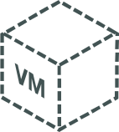



FORTINET SECURITY FABRIC
Management-analytics
ВСЕОБЪЕМЛЮЩАЯ
Обзор & Защита
всей поверхности атак
Partner api
Multi-cloud
ИНТЕГРИРОВАННАЯ
Предотвращение таргетированных атак
Iot-endpoint
Web apps
network
АВТОМАТИЗИРОВАННАЯ
Ответные меры & постоянный мониторинг окружения
Unified access
Email
Advanced threat protection
Single Pane of Glass (Management)
Single Source of Threat Intelligence
Single Network Operating System
Appliance
Virtual Machine
Hosted
Cloud
Software
Notes:
Only Fortinet’s approach towards cyber security can support such security transformation.
Fortinet’s security vision is made for the digital enterprise. It’s the Fortinet Security Fabric
FSF integrates data and security across all of the digital IT environment, from IoT to the cloud. It enables threat intelligence sharing throughout and gives visibility all across. It brings ease of control and management of the entire enterprise security infrastructure.
The Security Fabric allows security to dynamically expand and adapt as organizations go though their digital transformation journey.
But better to see the fabric in action (click)

Slide 18





Всеобъемлющая защита инфраструктуры
Защита
Конечных
узлов
Защита от
Целенаправленных
атак
Защита
веб-приложений
Защита сети
Защита в
Гетерогенных
облаках
Защищенный
унифицированный
доступ
Защита
сообщений
Управление и
аналитика
Multi
IoT
Web
Unified
Advanced
Management
Cloud
Endpoint
Email
Applications
Access
Threat
Protection
Analytics
FortiGate
Virtual Firewall
Network Security
FortiClient
EPP
FortiMail
Secure Email
Gateway
FortiWeb
Web Application
Firewall
FortiAP
Wireless
Infrastructure
FortiSandbox
Advanced Threat
Protection
FortiAnalyzer
Central Logging /Reporting
FortiGate
Enterprise Firewall
FortiGate
Cloud Firewall
Network Security
FortiManager
Central Security Management
FortiSwitch
Switching
Infrastructure
IPS
SD-WAN
SD-WAN
FortiSIEM
Security Information & Event Management
SWG
VPN
FortiCASB

Slide 19








Цифровая трансформация значительно расширяет поверхность атаки
Сеть
Устройства
Облако
SaaS
Private
Segmentation
Меньше
видимости
Private
Public
Меньше
контроля
SDN
Public
IoT
oT
SaaS
SaaS
SD - WAN
Speed
Encryption
Поверхность атаки

Slide 20





Архитектура адаптивной безопасности
Оборудование + ПО + Сервисы
Обновления FortiGuard
IoT
Hardware
FortiGate
Hardware
Fortinet
Cloud
FortiGate
VM
Public | Private
Cloud
Public | Private
Cloud
ПАК
Хостинг
Виртуальная
Машина
Облако
Контейнеры

Slide 21

















Fortinet Security Fabric - топология
Fabric
Integration
4
Cloud NGFW
Email
WAF
Manager
Analyzer
SaaS / CASB
1
WiFi.1
3
1
2
3
Internet
Virtual FW
NGFW
NGFW
ISFW.1
Switch.1
WiFi.2
3
клиенты (устройства)
3
ISFW.2
Switch.2
WiFi.3
1
SD-WAN
NGFW
Advanced Threat
Protection
Switch.3
Узлы (приложения)
5
2
1
3
3
7
1
1
1
1
1

Slide 22

Security rating service
Security
Rating
Vulnerability Scan
1
Access Security Fabric FortiGate
2
Audit
3
Easy Apply
All Results
500
354
25
65
31
22
Passed
Low
Medium
High
Critical
9,564
569
126
27
6
Passed
Low
Medium
High
Critical

Slide 23










WorkFlow - автоматизация
Automation
System
Events
Threat
Alerts
User & Device
Status
External
Inputs
Notification
Reports
Quarantine
Adjust
Configuration
Триггеры
Автоматизация реагирования
Действия
Автоматизация позволяет предпринять соответствующие действия без вовлечения администраторов (например, помещение в карантин)

Slide 24
FORTINET SECURITY FABRIC
Management-analytics
ВСЕОБЪЕМЛЮЩАЯ
Обзор & Защита
всей поверхности атак
Partner api
Multi-cloud
ИНТЕГРИРОВАННАЯ
Предотвращение таргетированных атак
Iot-endpoint
Web apps
network
АВТОМАТИЗИРОВАННАЯ
Ответные меры & постоянный мониторинг окружения
Unified access
Email
Advanced threat protection
Single Pane of Glass (Management)
Single Source of Threat Intelligence
Single Network Operating System
Appliance
Virtual Machine
Hosted
Cloud
Software
Notes:
Only Fortinet’s approach towards cyber security can support such security transformation.
Fortinet’s security vision is made for the digital enterprise. It’s the Fortinet Security Fabric
FSF integrates data and security across all of the digital IT environment, from IoT to the cloud. It enables threat intelligence sharing throughout and gives visibility all across. It brings ease of control and management of the entire enterprise security infrastructure.
The Security Fabric allows security to dynamically expand and adapt as organizations go though their digital transformation journey.
But better to see the fabric in action (click)

Slide 25
















Основные технологии, но есть одно “но” – ГОСТ шифрование?
FORTIOS
FORTIGUARD
PARALLEL PROCESSING
SPU
CPU
Accelerates
Network
Traffic
Accelerates
Content Inspection
Fabric
Use Cases
Security Rating
Threat Intelligence
Flexible
Policy
Connectors
API
Web Filtering
FortiSandbox
Cloud
Optimized for entry-level form factors
Automation
Fabric Agent
Intrusion Prevention
Antivirus
More Performance
Less Latency
CASB
Orchestration
Application Control
IP Reputation
Less Power
Less Space
Notes:
A Fortinet Security Fabric is made possible by three foundational components:
1- FortiOS, the operating system that contains the feature sets to support deployment anywhere in the network, with APIs and connectors that establish peer to peer information sharing and automation and orchestration capabilities for fast response.
2- FortiGuard Labs, the threat research team that delivers the real-time security intelligence to protect, detect and respond to the latest cyberattacks.
3- Fortinet Security Processors that accelerate the application of that security intelligence to production traffic with higher performance, lower latency and less space and power consumption in order to deploy anywhere.

Slide 26
Одно “НО”, как быть с ГОСТ Криптографией?
Вариант №1 Встроить в программное обеспечение межсетевого экрана?
Минусы решения:
падение производительности оборудования из-за дополнительной нагрузки на процессор
сложность получения сертификации ФСБ на изделие
Вариант №2 Встроить в сертифицированное оборудование другой сертифицированный модуль при локальном производстве оборудования

